Slide 1
Final Presentation: Deliverable # 1
Matthew Hogan

Slide 2
The Problem
Major asset classes were highly correlated during market turmoil of 2007-10:
Equities (stock)
Fixed Income (debt)
Cash and cash equivalents (savings, money markets)
Real Estate (direct, indirect)
Commodity (mined items or items collected in raw form: timber)
From 2007-2009 everyone sold everything and everything lost value. Traditional asset allocation and diversification doesn’t work during these cycles.
Massive implications to retirees and people living off saving’s/ investments during time of extended market disruption.

Slide 3
Data - example
Notes:
https://screener.fidelity.com/ftgw/etf/goto/snapshot/portfolioComposition.jhtml?symbols=AGG

Slide 4
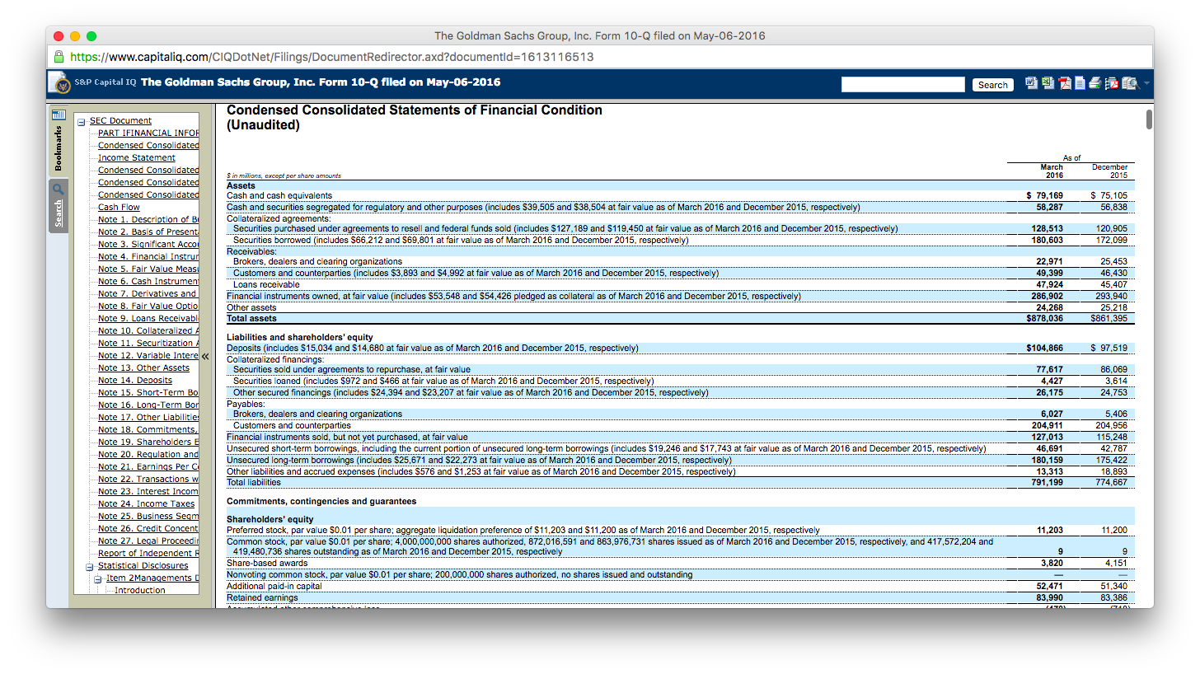
Data - example

Slide 5
Data Sources
S&P Capital IQ, Bloomberg, Morningstar Advisor Workstation
Yahoo Finance, Google Finance, Google Analytics
Sell-side sales desks: JP Morgan, Wells Fargo, Morgan Stanley, etc.
WSJ, Financial Times, Investopedia
Quantopian, Psychsignal

Slide 6
Hypothesis
Designing a basket of assets/ a portfolio with minimal overlap and a correlation is as close to -1 will yield better results than general indexing or generic asset allocation.
Success could be defined as achieving losses no greater than -10% within the portfolio over a 30 year cycle.
30 years – average retirement duration for baby boomers.
S&P 500 returned -37% in 2008.

